Slide 1
Association Rule Mining

Slide 2
What Is Frequent Pattern Analysis?
Frequent pattern: a pattern (a set of items, subsequences, substructures, etc.) that occurs frequently in a data set
First proposed by Agrawal, Imielinski, and Swami [AIS93] in the context of frequent itemsets and association rule mining
Motivation: Finding inherent regularities in data
What products were often purchased together?— Beer and diapers?!
What are the subsequent purchases after buying a PC?
What kinds of DNA are sensitive to this new drug?
Can we automatically classify web documents?
Applications
Basket data analysis, cross-marketing, catalog design, sale campaign analysis, Web log (click stream) analysis, and DNA sequence analysis.

Slide 3
Basic Concepts: Frequent Patterns
Tid | Items bought
10 | Beer, Nuts, Diaper
20 | Beer, Coffee, Diaper
30 | Beer, Diaper, Eggs
40 | Nuts, Eggs, Milk
50 | Nuts, Coffee, Diaper, Eggs, Milk
itemset: A set of one or more items
k-itemset X = {x₁, …, x_{k}}
(absolute) support, or, support count of X: Frequency or occurrence of an itemset X
(relative) support, s, is the fraction of transactions that contains X (i.e., the probability that a transaction contains X)
An itemset X is frequent if X’s support is no less than a minsup threshold
Customer
buys both
Customer
buys diaper
Customer
buys beer

Slide 4
Basic Concepts: Association Rules
Tid
Items bought
Find all the rules X → Y with minimum support and confidence
support, s, probability that a transaction contains X ∪ Y
confidence, c, conditional probability that a transaction having X also contains Y
Let minsup = 50%, minconf = 50%
Freq. Pat.: Beer:3, Nuts:3, Diaper:4, Eggs:3, {Beer, Diaper}:3
10
Beer, Nuts, Diaper
20
Beer, Coffee, Diaper
30
Beer, Diaper, Eggs
40
Nuts, Eggs, Milk
50
Nuts, Coffee, Diaper, Eggs, Milk
Customer
buys both
Customer
buys diaper
Customer
buys beer
Association rules: (many more!)
Beer → Diaper (60%, 100%)
Diaper → Beer (60%, 75%)

Slide 5
Apriori: A Candidate Generation-and-Test Approach

Slide 6
The Downward Closure Property and Scalable Mining Methods
The downward closure property of frequent patterns
Any subset of a frequent itemset must be frequent
If {beer, diaper, nuts} is frequent, so is {beer, diaper}
i.e., every transaction having {beer, diaper, nuts} also contains {beer, diaper}
Scalable mining methods: Three major approaches
Apriori (Agrawal & Srikant@VLDB’94)
Freq. pattern growth (FPgrowth—Han, Pei & Yin @SIGMOD’00)
Vertical data format approach (Charm—Zaki & Hsiao @SDM’02)

Slide 7
Apriori: A Candidate Generation & Test Approach
Apriori pruning principle: If there is any itemset which is infrequent, its superset should not be generated/tested! (Agrawal & Srikant @VLDB’94, Mannila, et al. @ KDD’ 94)
Method:
Initially, scan DB once to get frequent 1-itemset
Generate length (k+1) candidate itemsets from length k frequent itemsets
Test the candidates against DB
Terminate when no frequent or candidate set can be generated

Slide 8
The Apriori Algorithm—An Example
Sup_{min} = 2
Itemset | sup
{A} | 2
{B} | 3
{C} | 3
{D} | 1
{E} | 3
Database TDB
Itemset | sup
{A} | 2
{B} | 3
{C} | 3
{E} | 3
L₁
Tid | Items
10 | A, C, D
20 | B, C, E
30 | A, B, C, E
40 | B, E
C₁
1st scan
C₂
Itemset | sup
{A, B} | 1
{A, C} | 2
{A, E} | 1
{B, C} | 2
{B, E} | 3
{C, E} | 2
C₂
Itemset
{A, B}
{A, C}
{A, E}
{B, C}
{B, E}
{C, E}
L₂
Itemset | sup
{A, C} | 2
{B, C} | 2
{B, E} | 3
{C, E} | 2
2nd scan
C₃
Itemset
{B, C, E}
3rd scan
L₃
Itemset | sup
{B, C, E} | 2

Slide 9
The Apriori Algorithm (Pseudo-Code)
C_{k}: Candidate itemset of size k
L_{k} : frequent itemset of size k
L₁ = {frequent items};
for (k = 1; L_{k} !=∅; k++) do begin
C_{k+1} = candidates generated from L_{k};
for each transaction t in database do
increment the count of all candidates in C_{k+1} that are contained in t
L_{k+1} = candidates in C_{k+1} with min_support
end
return ∪_{k} L_{k};

Slide 10
Implementation of Apriori
How to generate candidates?
Step 1: self-joining L_{k}
Step 2: pruning
Example of Candidate-generation
L₃={abc, abd, acd, ace, bcd}
Self-joining: L₃*L₃
abcd from abc and abd
acde from acd and ace
Pruning:
acde is removed because ade is not in L₃
C₄ = {abcd}

Slide 11
Frequent Itemset Generation
Given d items, there are 2^{d} possible candidate itemsets

Slide 12
Frequent Itemset Generation Strategies
Reduce the number of candidates (M)
Complete search: M=2^{d}
Use pruning techniques to reduce M
Reduce the number of transactions (N)
Reduce size of N as the size of itemset increases
Used by DHP and vertical-based mining algorithms
Reduce the number of comparisons (NM)
Use efficient data structures to store the candidates or transactions
No need to match every candidate against every transaction

Slide 13
Reducing Number of Candidates
Apriori principle:
If an itemset is frequent, then all of its subsets must also be frequent
Apriori principle holds due to the following property of the support measure:
Support of an itemset never exceeds the support of its subsets
This is known as the anti-monotone property of support

Slide 14
Illustrating Apriori Principle
Found to be Infrequent
Pruned supersets

Slide 15
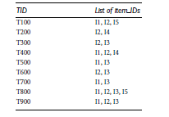

Slide 16
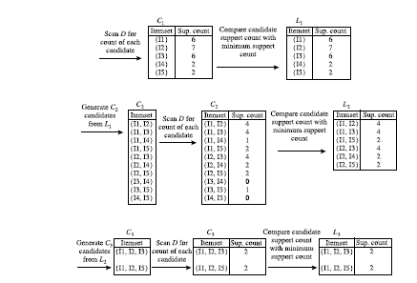

Slide 17
Association Analysis: Basic Concepts and Algorithms
Algorithms and Complexity

Slide 18
Factors Affecting Complexity of Apriori
Choice of minimum support threshold
lowering support threshold results in more frequent itemsets
this may increase number of candidates and max length of frequent itemsets
Dimensionality (number of items) of the data set
more space is needed to store support count of each item
if number of frequent items also increases, both computation and I/O costs may also increase
Size of database
since Apriori makes multiple passes, run time of algorithm may increase with number of transactions
Average transaction width
transaction width increases with denser data sets
This may increase max length of frequent itemsets and traversals of hash tree (number of subsets in a transaction increases with its width)

Slide 19
Compact Representation of Frequent Itemsets
Some itemsets are redundant because they have identical support as their supersets
Number of frequent itemsets
Need a compact representation

Slide 20
Maximal Frequent Itemset
An itemset is maximal frequent if it is frequent and none of its immediate supersets is frequent
Maximal Itemsets
Infrequent Itemsets
Border

Slide 21
What are the Maximal Frequent Itemsets in this Data?
Minimum support threshold = 5

Slide 22
An illustrative example
Items
 | A | B | C | D | E | F | G | H | I | J
1
2
3
4
5
6
7
8
9
10
Support threshold (by count) : 5
Frequent itemsets: ?
Transactions

Slide 23
An illustrative example
Items
 | A | B | C | D | E | F | G | H | I | J
1
2
3
4
5
6
7
8
9
10
Support threshold (by count) : 5
Frequent itemsets: {F}
Transactions

Slide 24
An illustrative example
Items
 | A | B | C | D | E | F | G | H | I | J
1
2
3
4
5
6
7
8
9
10
Support threshold (by count) : 5
Frequent itemsets: {F}
Support threshold (by count): 4
Frequent itemsets: ?
Transactions

Slide 25
An illustrative example
Items
 | A | B | C | D | E | F | G | H | I | J
1
2
3
4
5
6
7
8
9
10
Support threshold (by count) : 5
Frequent itemsets: {F}
Support threshold (by count): 4
Frequent itemsets: {E}, {F}, {E,F}, {J}
Transactions

Slide 26
An illustrative example
Items
 | A | B | C | D | E | F | G | H | I | J
1
2
3
4
5
6
7
8
9
10
Support threshold (by count) : 5
Frequent itemsets: {F}
Support threshold (by count): 4
Frequent itemsets: {E}, {F}, {E,F}, {J}
Support threshold (by count): 3
Frequent itemsets: ?
Transactions

Slide 27
An illustrative example
Items
 | A | B | C | D | E | F | G | H | I | J
1
2
3
4
5
6
7
8
9
10
Support threshold (by count) : 5
Frequent itemsets: {F}
Support threshold (by count): 4
Frequent itemsets: {E}, {F}, {E,F}, {J}
Support threshold (by count): 3
Frequent itemsets:
All subsets of {C,D,E,F} + {J}
Transactions

Slide 28
An illustrative example
Items
 | A | B | C | D | E | F | G | H | I | J
1
2
3
4
5
6
7
8
9
10
Support threshold (by count) : 5
Frequent itemsets: {F}
Maximal itemsets: ?
Support threshold (by count): 4
Frequent itemsets: {E}, {F}, {E,F}, {J}
Maximal itemsets: ?
Support threshold (by count): 3
Frequent itemsets:
All subsets of {C,D,E,F} + {J}
Maximal itemsets: ?
Transactions

Slide 29
An illustrative example
Items
 | A | B | C | D | E | F | G | H | I | J
1
2
3
4
5
6
7
8
9
10
Support threshold (by count) : 5
Frequent itemsets: {F}
Maximal itemsets: {F}
Support threshold (by count): 4
Frequent itemsets: {E}, {F}, {E,F}, {J}
Maximal itemsets: ?
Support threshold (by count): 3
Frequent itemsets:
All subsets of {C,D,E,F} + {J}
Maximal itemsets: ?
Transactions

Slide 30
An illustrative example
Items
 | A | B | C | D | E | F | G | H | I | J
1
2
3
4
5
6
7
8
9
10
Support threshold (by count) : 5
Frequent itemsets: {F}
Maximal itemsets: {F}
Support threshold (by count): 4
Frequent itemsets: {E}, {F}, {E,F}, {J}
Maximal itemsets: {E,F}, {J}
Support threshold (by count): 3
Frequent itemsets:
All subsets of {C,D,E,F} + {J}
Maximal itemsets: ?
Transactions

Slide 31
An illustrative example
Items
 | A | B | C | D | E | F | G | H | I | J
1
2
3
4
5
6
7
8
9
10
Support threshold (by count) : 5
Frequent itemsets: {F}
Maximal itemsets: {F}
Support threshold (by count): 4
Frequent itemsets: {E}, {F}, {E,F}, {J}
Maximal itemsets: {E,F}, {J}
Support threshold (by count): 3
Frequent itemsets:
All subsets of {C,D,E,F} + {J}
Maximal itemsets:
{C,D,E,F}, {J}
Transactions

Slide 32
Another illustrative example
Items
 | A | B | C | D | E | F | G | H | I | J
1
2
3
4
5
6
7
8
9
10
Support threshold (by count) : 5
Maximal itemsets: {A}, {B}, {C}
Support threshold (by count): 4
Maximal itemsets: {A,B}, {A,C},{B,C}
Support threshold (by count): 3
Maximal itemsets: {A,B,C}
Transactions

Slide 33
Closed Itemset
An itemset X is closed if none of its immediate supersets has the same support as the itemset X.
X is not closed if at least one of its immediate supersets has support count as X.

Slide 34
Frequent Itemset Generation

Slide 35
Maximal vs Closed Itemsets
Transaction Ids
Not supported by any transactions

Slide 36
Maximal vs Closed Frequent Itemsets
Minimum support = 2
Closed but not maximal
Closed and maximal
# Closed = 9
# Maximal = 4

Slide 37
Example 1
Items
 | A | B | C | D | E | F | G | H | I | J
1
2
3
4
5
6
7
8
9
10
Itemsets | Support (counts) | Closed itemsets
{C} | 3
{D} | 2
{C,D} | 2
Transactions

Slide 38
Example 1
Items
 | A | B | C | D | E | F | G | H | I | J
1
2
3
4
5
6
7
8
9
10
Itemsets | Support (counts) | Closed itemsets
{C} | 3 | ✓
{D} | 2
{C,D} | 2 | ✓
Transactions

Slide 39
Example 2
Items
 | A | B | C | D | E | F | G | H | I | J
1
2
3
4
5
6
7
8
9
10
Itemsets | Support (counts) | Closed itemsets
{C} | 3
{D} | 2
{E} | 2
{C,D} | 2
{C,E} | 2
{D,E} | 2
{C,D,E} | 2
Transactions

Slide 40
Example 2
Items
 | A | B | C | D | E | F | G | H | I | J
1
2
3
4
5
6
7
8
9
10
Itemsets | Support (counts) | Closed itemsets
{C} | 3 | ✓
{D} | 2
{E} | 2
{C,D} | 2
{C,E} | 2
{D,E} | 2
{C,D,E} | 2 | ✓
Transactions

Slide 41
Example 3
Items
 | A | B | C | D | E | F | G | H | I | J
1
2
3
4
5
6
7
8
9
10
Closed itemsets: {C,D,E,F}, {C,F}
Transactions

Slide 42
Example 4
Items
 | A | B | C | D | E | F | G | H | I | J
1
2
3
4
5
6
7
8
9
10
Closed itemsets: {C,D,E,F}, {C}, {F}
Transactions

Slide 43
Maximal vs Closed Itemsets

Slide 44
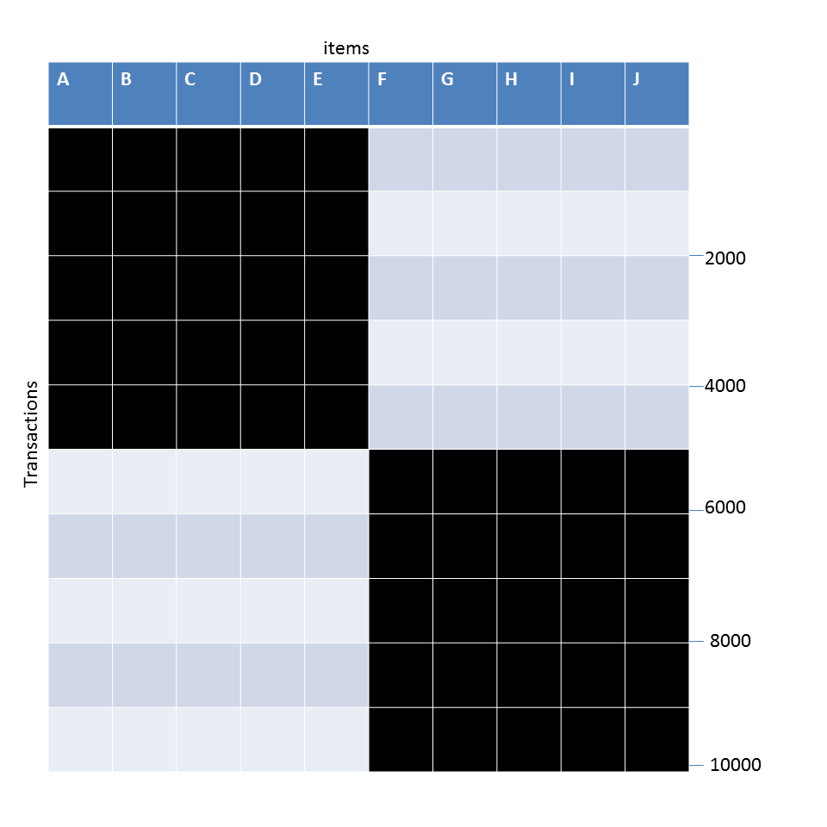
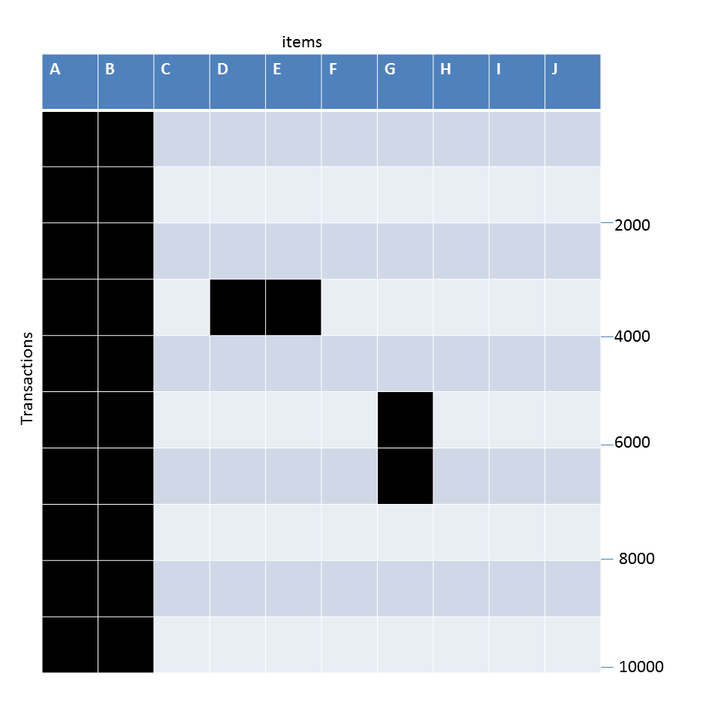
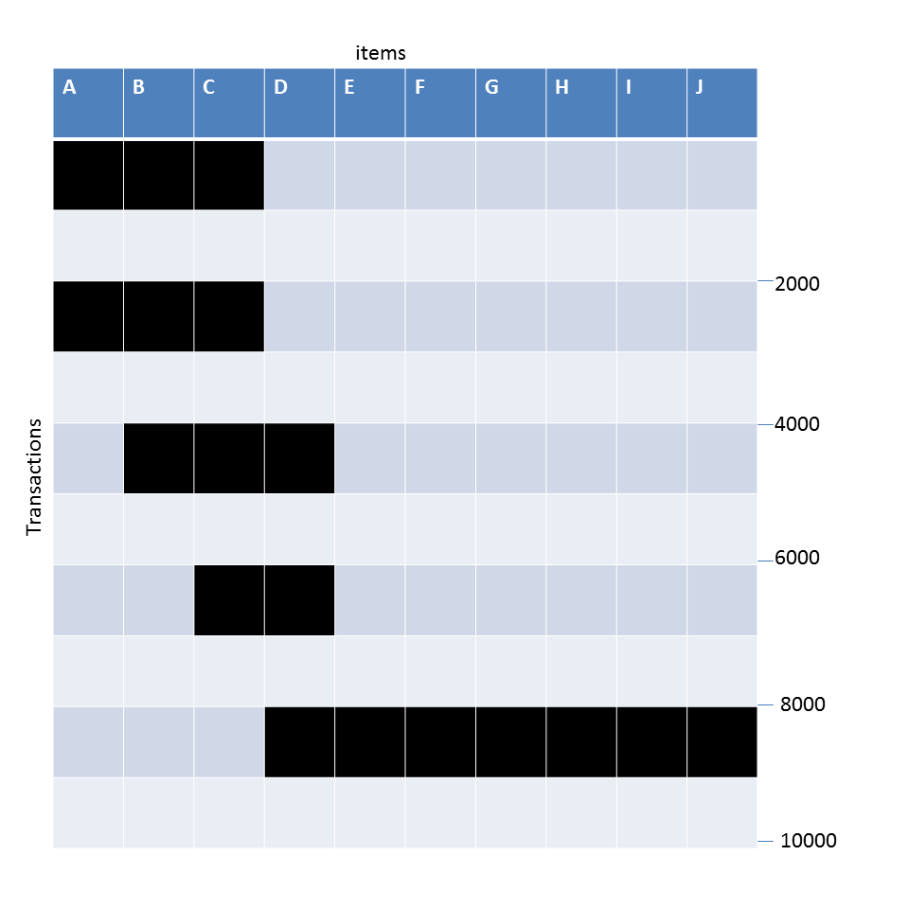
Example question
Given the following transaction data sets (dark cells indicate presence of an item in a transaction) and a support threshold of 20%, answer the following questions
What is the number of frequent itemsets for each dataset? Which dataset will produce the most number of frequent itemsets?
Which dataset will produce the longest frequent itemset?
Which dataset will produce frequent itemsets with highest maximum support?
Which dataset will produce frequent itemsets containing items with widely varying support levels (i.e., itemsets containing items with mixed support, ranging from 20% to more than 70%)?
What is the number of maximal frequent itemsets for each dataset? Which dataset will produce the most number of maximal frequent itemsets?
What is the number of closed frequent itemsets for each dataset? Which dataset will produce the most number of closed frequent itemsets?

Slide 45
Ref: Basic Concepts of Frequent Pattern Mining
(Association Rules) R. Agrawal, T. Imielinski, and A. Swami. Mining association rules between sets of items in large databases. SIGMOD'93
(Max-pattern) R. J. Bayardo. Efficiently mining long patterns from databases. SIGMOD'98
(Closed-pattern) N. Pasquier, Y. Bastide, R. Taouil, and L. Lakhal. Discovering frequent closed itemsets for association rules. ICDT'99
(Sequential pattern) R. Agrawal and R. Srikant. Mining sequential patterns. ICDE'95

Slide 46
Ref: Apriori and Its Improvements
R. Agrawal and R. Srikant. Fast algorithms for mining association rules. VLDB'94
H. Mannila, H. Toivonen, and A. I. Verkamo. Efficient algorithms for discovering association rules. KDD'94
A. Savasere, E. Omiecinski, and S. Navathe. An efficient algorithm for mining association rules in large databases. VLDB'95
J. S. Park, M. S. Chen, and P. S. Yu. An effective hash-based algorithm for mining association rules. SIGMOD'95
H. Toivonen. Sampling large databases for association rules. VLDB'96
S. Brin, R. Motwani, J. D. Ullman, and S. Tsur. Dynamic itemset counting and implication rules for market basket analysis. SIGMOD'97
S. Sarawagi, S. Thomas, and R. Agrawal. Integrating association rule mining with relational database systems: Alternatives and implications. SIGMOD'98

Slide 47
Ref: Depth-First, Projection-Based FP Mining
R. Agarwal, C. Aggarwal, and V. V. V. Prasad. A tree projection algorithm for generation of frequent itemsets. J. Parallel and Distributed Computing, 2002.
G. Grahne and J. Zhu, Efficiently Using Prefix-Trees in Mining Frequent Itemsets, Proc. FIMI'03
B. Goethals and M. Zaki. An introduction to workshop on frequent itemset mining implementations. Proc. ICDM’03 Int. Workshop on Frequent Itemset Mining Implementations (FIMI’03), Melbourne, FL, Nov. 2003
J. Han, J. Pei, and Y. Yin. Mining frequent patterns without candidate generation. SIGMOD’ 00
J. Liu, Y. Pan, K. Wang, and J. Han. Mining Frequent Item Sets by Opportunistic Projection. KDD'02
J. Han, J. Wang, Y. Lu, and P. Tzvetkov. Mining Top-K Frequent Closed Patterns without Minimum Support. ICDM'02
J. Wang, J. Han, and J. Pei. CLOSET+: Searching for the Best Strategies for Mining Frequent Closed Itemsets. KDD'03

Slide 48
Ref: Vertical Format and Row Enumeration Methods
M. J. Zaki, S. Parthasarathy, M. Ogihara, and W. Li. Parallel algorithm for discovery of association rules. DAMI:97.
M. J. Zaki and C. J. Hsiao. CHARM: An Efficient Algorithm for Closed Itemset Mining, SDM'02.
C. Bucila, J. Gehrke, D. Kifer, and W. White. DualMiner: A Dual-Pruning Algorithm for Itemsets with Constraints. KDD’02.
F. Pan, G. Cong, A. K. H. Tung, J. Yang, and M. Zaki , CARPENTER: Finding Closed Patterns in Long Biological Datasets. KDD'03.
H. Liu, J. Han, D. Xin, and Z. Shao, Mining Interesting Patterns from Very High Dimensional Data: A Top-Down Row Enumeration Approach, SDM'06.

Slide 49
Ref: Mining Correlations and Interesting Rules
S. Brin, R. Motwani, and C. Silverstein. Beyond market basket: Generalizing association rules to correlations. SIGMOD'97.
M. Klemettinen, H. Mannila, P. Ronkainen, H. Toivonen, and A. I. Verkamo. Finding interesting rules from large sets of discovered association rules. CIKM'94.
R. J. Hilderman and H. J. Hamilton. Knowledge Discovery and Measures of Interest. Kluwer Academic, 2001.
C. Silverstein, S. Brin, R. Motwani, and J. Ullman. Scalable techniques for mining causal structures. VLDB'98.
P.-N. Tan, V. Kumar, and J. Srivastava. Selecting the Right Interestingness Measure for Association Patterns. KDD'02.
E. Omiecinski. Alternative Interest Measures for Mining Associations. TKDE’03.
T. Wu, Y. Chen, and J. Han, “Re-Examination of Interestingness Measures in Pattern Mining: A Unified Framework", Data Mining and Knowledge Discovery, 21(3):371-397, 2010

